Slide 1

Transforming Supply Chain Data into Actionable Store-Level Insights
A 3-Tier Business Intelligence Application for Predictive Demand and Inventory Control, mapping transactional data to physical retail operations.
Presented by:
RIMIYA RIMSHI K M
DATA SCIENCE

Slide 2


The Business Problem
Capital Lockup & Carrying Costs
The Forecast-Sales Disconnection
Retail operations face severe financial friction due to unoptimized inventory distribution networks:
A severe operational gap exists between macro planning forecasts and local storefront actions:
■
Massive Overstock Surplus: Corporate buffer margins systematically overstock regional warehouses, locking up crucial working capital.
■
Decoupled Forecasting: Demand planners generate aggregate seasonal curves that deviate heavily from actual localized store consumption.
■
Static Safety Thresholds: Relying on static purchase orders ignores short-term regional volatility and demand deceleration.
■
Information Asymmetry: Store managers lack access to high-level analytical dashboards, leading to execution failures.
■
Financial Friction: Unsold stock racks up high carrying costs, reducing overall liquidity and shelf agility.
■
No Local Action Plans: Visual data is rarely translated into direct task instructions, leaving shelf stock unbalanced and competitive pricing unaligned.

Slide 3






The Three-Tier Framework
Tier 1: Executive
Tier 2: Planning
Tier 3: Operations
Macro-level visibility tracking overall revenue and absolute stockout risk vectors across our regional supply hubs.
Advanced statistical demand metrics refining forecasting logic to decrease error margins in high-volume regions.
Granular live-action grids translated specifically to direct localized storefront execution points daily.

Slide 4
TIER 1 DASHBOARD FOCUS
Executive Inventory Overview
Analyzing macro performance, localized revenue drivers, and supply chain health based on metrics visualized in Screenshot 2026-06-19 210514.png.

Slide 5




Executive Key Performance Indicators
TOTAL REVENUE
TOTAL UNITS SOLD
TOTAL UNITS ORDERED
STOCKOUT OCCURRENCES
$494.97M
10M
8M
0
Operational Success
Balanced Flow
Having 0 Stockout Occurrences ensures absolute customer goodwill and continuous market presence across all regional hubs.
The direct 1:1 balance of 2M Units Sold vs. 2M Units Ordered highlights a highly streamlined, zero-leak transactional loop.

Slide 6
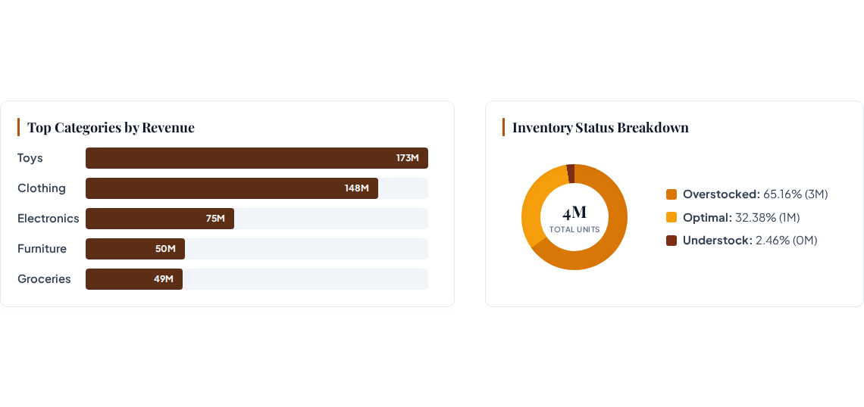
Revenue & Inventory Segmentation

Slide 7
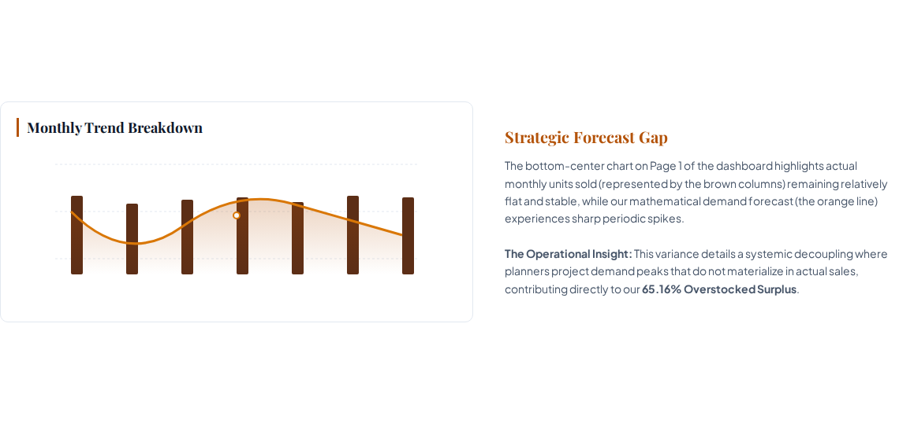
Units Sold vs Demand Forecast

Slide 8
TIER 2 DASHBOARD FOCUS
Demand Forecasting & Supply Chain
A closer look at statistical modeling health, promotional metrics, and localized accuracy tables.

Slide 9
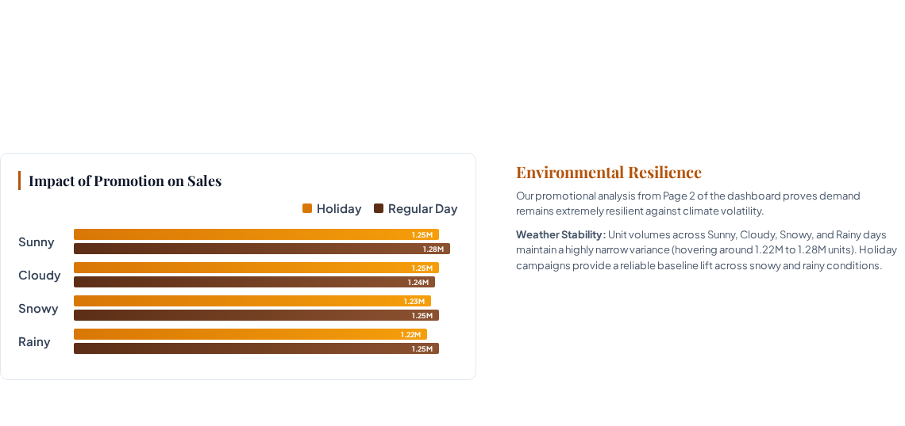


Planning Metrics & Environmental Impacts
FORECAST ACCURACY %
FORECAST ERROR
AVERAGE OF DISCOUNT
93.89%
368K
10.01

Slide 10

Regional Performance Matrix
Category / Metric | East Region | North Region | South Region | West Region | Total Average
Clothing (Accuracy %) | 93.92% | 93.84% | 93.88% | 93.85% | 93.88%
Absolute Forecast Error | 45,138 | 45,302 | 46,500 | 45,899 | 182,839
Electronics (Accuracy %) | 94.01% | 93.93% | 94.12% | 93.90% | 93.99%
Absolute Forecast Error | 23,273 | 22,772 | 21,989 | 22,958 | 90,992
Global Model Summary | 93.96% | 93.88% | 93.89% | 93.83% | 93.89%
Data source: SUPPLY CHAIN PERFORMANCE GRID from Screenshot 2026-06-19 210529.png. Model performance displays identical, highly stable forecasting health across all geographic zones.

Slide 11
TIER 3 DASHBOARD FOCUS
Store-Level Operational Action
Operationalizing insights into price premium policies, active margins, and daily localized tasks.

Slide 12
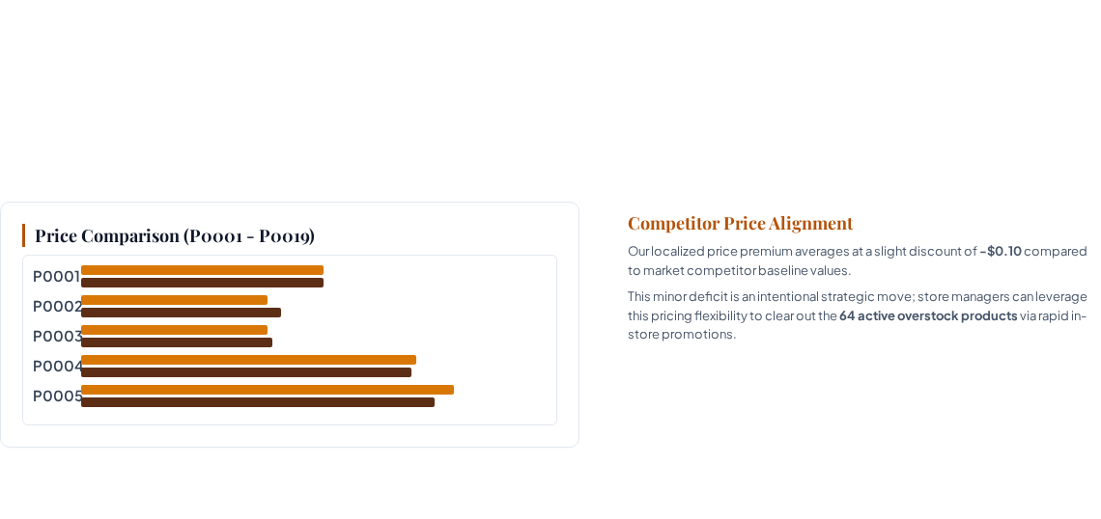



Tier 3 Operational Indicators
STOCKOUT OCCURRENCES
OVERSTOCKED PRODUCTS COUNT
PRICE PREMIUM
0
64
($0.10)

Slide 13

The Store Manager's Live Action Grid
Store ID | Product ID | Category | Sum of Demand Forecast | Inventory Status State
S003 | P0001 | Clothing | 120 | Optimal Stock
S002 | P0001 | Clothing | 27 | Overstocked Surplus
S004 | P0001 | Electronics | 490 | Optimal Stock
S004 | P0002 | Furniture | 193 | Understocked Risk
S003 | P0002 | Groceries | 235 | Overstocked Surplus
Prescriptive check sheet mapped directly to localized manager logins, enabling dynamic markdown triggers in real-time.

Slide 14

THANK YOU

